Slide 1
Chapter 1
Introduction to Entrepreneurship
Bruce R. Barringer
R. Duane Ireland
1-<number>

Slide 2
Chapter Objectives
1 of 2
Explain entrepreneurship and discuss its importance.
Describe corporate entrepreneurship and its use in established firms.
Discuss three main reasons people decide to become entrepreneurs.
Identify four main characteristics of successful entrepreneurs.
Explain five common myths regarding entrepreneurship.
2-<number>

Slide 3
Chapter Objectives
2 of 2
Explain how entrepreneurial firms differ from salary-substitute and lifestyle firms.
Discuss the impact of entrepreneurial firms on economies and societies.
Identify ways in which large firms benefit from the presence of smaller entrepreneurial firms.
Explain the entrepreneurial process.
2-<number>

Slide 4
Introduction to Entrepreneurship
According to the GEM
study, 9.6% of Americans
are actively engaged in
starting a business or are
the owner/manager of a
business that is less than
three years old.
There is tremendous interest in entrepreneurship in the U.S. and around the world.
1-<number>

Slide 5
What is Entrepreneurship?
Definition (Robert D & M.P.Peters)
  Process by which individuals pursue opportunities without regard to resources they currently control.
  Entrepreneurship is the process of creating something new and assuming the risk and rewards.
(Fred Wilson)
  Entrepreneurship is the art of turning an idea into a business.
Explanation of What Entrepreneurs Do
  Entrepreneurs assemble and then integrate all the resources needed –the money, the people, the business model, the strategy—needed to transform an invention or an idea into a viable business.
1-<number>

Slide 6
Entrepreneurship
1 of 2
Entrepreneurship
  Is the process to creating something new of value by devoting (giving) the time and effort.
  By accepting and acknowledging the necessary financial, social and psychological risks.
  Finally receiving the rewards and freedom to do what you want.
1-<number>

Slide 7
Introduction to Entrepreneurship
What are different outcomes of engaging in entrepreneurship
Innovation and newness (product and services)
Creating new product and services
Generating wealth
Taking risk in business venture
Prepared to face uncertainty
Create job opportunity
1-<number>

Slide 8
Corporate Entrepreneurship
2 of 2
Entrepreneurial Firms
Conservative Firms
Proactive
Innovative
Risk taking
Take a more “wait and see”
posture
Less innovative
Risk adverse
1-<number>

Slide 9

Why Become an Entrepreneur?
The three primary reasons that people become entrepreneurs and start their own firms
Desire to be their own boss
Desire to pursue their
own ideas
Financial rewards
1-<number>

Slide 10
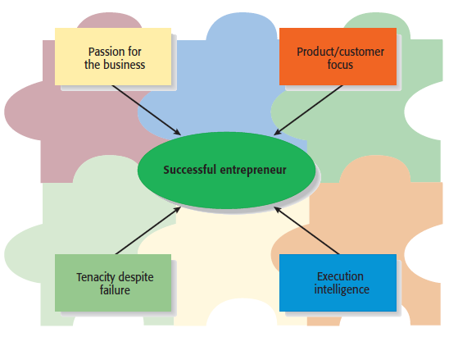
Characteristics of Successful Entrepreneurs
1 of 3
Four Primary Characteristics
1-<number>

Slide 11
Characteristics of Successful Entrepreneurs
2 of 3
Passion for the Business
  The number one characteristic shared by successful entrepreneurs is a passion for the business.
  This passion typically stems from the entrepreneur’s belief that the business will positively influence people’s lives.
Product/Customer Focus
  A second defining characteristic of successful entrepreneurs is a product/customer focus.
  An entrepreneur’s keen focus on products and customers typically stems from the fact that most entrepreneurs are, at heart, craftspeople.
1-<number>

Slide 12
Characteristics of Successful Entrepreneurs
3 of 3
Tenacity Despite Failure
  Because entrepreneurs are typically trying something new, the failure rate is naturally high.
  A defining characteristic for successful entrepreneurs’ is their ability to proceed through setbacks and failures.
Execution Intelligence
  The ability to fashion a solid business idea into a viable business is a key characteristic of successful entrepreneurs.
1-<number>

Slide 13
The Benefits of Entrepreneurship
Opportunity to create your own destiny.
Opportunity to make a difference.
Opportunity to reach your full potential.
Opportunity to reach extra ordinary profit.
Societal responsibility and recognition.
1-<number>

Slide 14
The Drawbacks of Entrepreneurship
Uncertainty of income
Risk of losing all investment
Long hours and hard work
Lower quality of life until business get established.
High level of stress.
1-<number>

Slide 15
Common Myths About Entrepreneurs
1 of 5
Myth 1: Entrepreneurs Are Born Not Made
  This myth is based on the mistaken belief that some people are genetically predisposed to be entrepreneurs.
  The consensus of many studies is that no one is “born” to be an entrepreneur; everyone has the potential to become one.
  Whether someone does or doesn’t become an entrepreneur, is a function of the environment, life experiences, and personal choices.
1-<number>

Slide 16
Common Myths About Entrepreneurs
2 of 5
Although no one is “born” to be an entrepreneur, there are common traits and characteristics of successful entrepreneurs
Achievement motivated
Alert to opportunities
Creative
Decisive
Energetic
Has a strong work ethic
Is a moderate risk taker
Is a networker
Lengthy attention span
Optimistic disposition
Persuasive
Promoter
Resource assembler
Self-confident
Self-starter
Tolerant of ambiguity
Visionary
1-<number>

Slide 17
Common Myths About Entrepreneurs
3 of 5
Myth 2: Entrepreneurs Are Gamblers
  Most entrepreneurs are moderate risk takers.
  The idea that entrepreneurs are gamblers originates from two sources:
    Entrepreneurs typically have jobs that are less structured, and so they face a more uncertain set of possibilities than people in traditional jobs.
    Many entrepreneurs have a strong need to achieve and set challenging goals, a behavior that is often equated with risk taking.
1-<number>

Slide 18
Common Myths About Entrepreneurs
4 of 5
Myth 3: Entrepreneurs Are Motivated Primarily by Money.
  While it is immature to think that entrepreneurs don’t seek financial rewards, money is rarely the reason entrepreneurs start new firms.
  In fact, some entrepreneurs warn that the pursuit of money can be distracting.
1-<number>

Slide 19
Common Myths About Entrepreneurs
5 of 5
Myth 4: Entrepreneurs Should Be Young and Energetic.
  The most active age for business ownership is 35 to 45 years old.
  While it is important to be energetic, investors often cite the strength of the entrepreneur as their most important criteria in making investment decisions.
    What makes an entrepreneur “strong” in the eyes of an investor is experience, maturity, a solid reputation, and a track record of success.
    These criteria favor older rather than younger entrepreneurs.
1-<number>

Slide 20
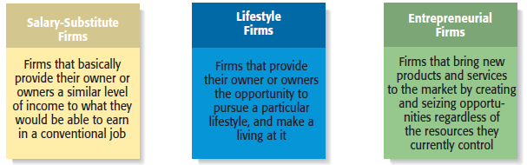
Types of Start-Up Firms
1-<number>

Slide 21
Economic Impact of Entrepreneurial Firms
Innovation
  Is the process of creating something new, which is central to the entrepreneurial process.
  Small firms are twice as innovative per employee as large firms.
Job Creation
  In the past two decades, economic activity has moved in the direction of smaller entrepreneurial firms, which may be due to their unique ability to innovate and focus on specialized tasks.
1-<number>

Slide 22
Entrepreneurial Firms’ Impact on Society and Larger Firms
Impact on Society
  The innovations of entrepreneurial firms have a dramatic impact on society.
  Think of all the new products and services that make our lives easier, enhance our productivity at work, improve our health, and entertain us in new ways.
Impact on Larger Firms
  Many entrepreneurial firms have built their entire business models around producing products and services that help larger firms become more efficient and effective.
1-<number>

Slide 23
The Entrepreneurial Process
The Entrepreneurial Process Consists of Four Steps
Step 1: Deciding to become an entrepreneur.
Step 2: Developing successful business ideas.
Step 3: Moving from an idea to an entrepreneurial firm.
Step 4: Managing and growing the entrepreneurial firm.
1-<number>

Slide 24
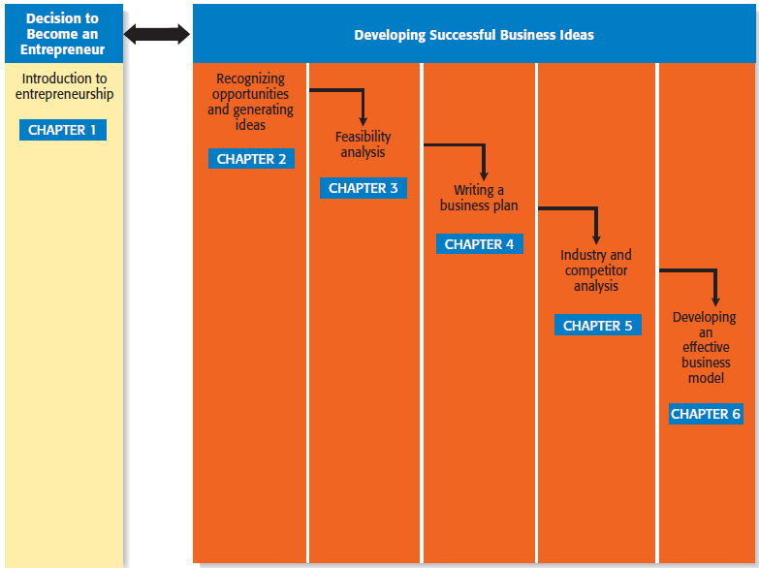
Steps in the Entrepreneurial Process
1 of 2
Step 1
Step 2
Developing Successful Business Ideas
1-<number>

Slide 25
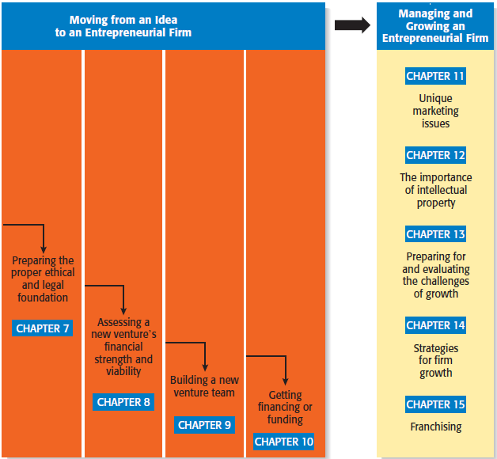
Steps in the Entrepreneurial Process
2 of 2
Step 3
Step 4
1-<number>

